Slide 1
Discrete Mathematics: Lecture 23 Part IV. Graph Theory Handshaking Theorem, Graph Transform, Graph Isomorphism, Bipartite Graph, Matching
Xuming He
Associate Professor
School of Information Science and Technology
ShanghaiTech University
Spring Semester, 2024
Notes by Prof. Liangfeng Zhang and Xuming He

Slide 2

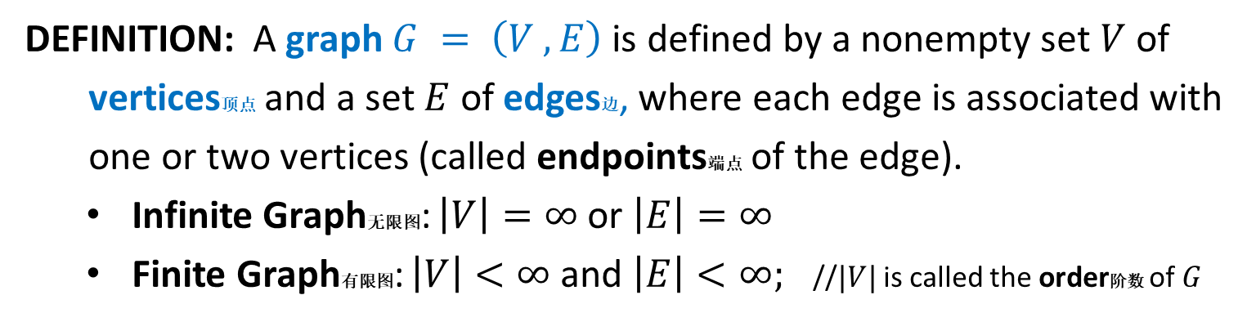



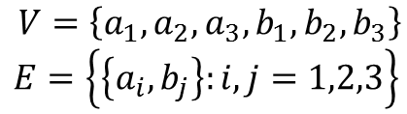



Review: Graph
DEFINITION: A graph $G = \left(V ,E\right)$ is defined by a nonempty set $V$ of
vertices顶点 and a set $E$ of edges边, where each edge is associated with
one or two vertices (called endpoints端点 of the edge).
Infinite Graph无限图: $\left|V\right|=∞$ or $\left|E\right|=∞$
Finite Graph有限图: $\left|V\right|<∞$ and $\left|E\right|<∞;$ //$|V|$ is called the order阶数 of $G$
$$a_{1}$$
$$a_{2}$$
$$a_{3}$$
$$(1,1)$$
$$(0,0)$$
$$(1,0)$$
$$(−1,−1)$$
$$b_{1}$$
$$b_{2}$$
$$b_{3}$$
$V=\left\{a_{1},a_{2},a_{3},b_{1},b_{2},b_{3}\right\}$
$$E=\left\{\left\{a_{i},b_{j}\right\}:i,j=1,2,3\right\}$$
$V=\left\{\left(i,j\right):i,j∈ℤ\right\}$
$$E=\left\{\left\{\left(a,b\right),\left(c,d\right)\right\}:\left|a−c\right|=1 or \left|b−d\right|=1\right\}$$

Slide 3
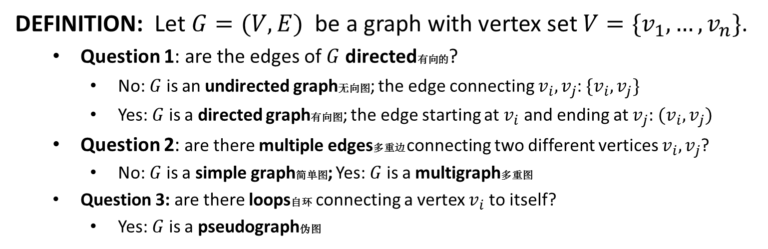
Review: Types of Graphs
DEFINITION: Let $G=(V,E)$ be a graph with vertex set $V=\{v_{1},…,v_{n}\}$.
Question 1: are the edges of $G$ directed有向的?
No: $G$ is an undirected graph无向图; the edge connecting $v_{i},v_{j}$: $\{v_{i},v_{j}\}$
Yes: $G$ is a directed graph有向图; the edge starting at $v_{i}$ and ending at $v_{j}:$ $(v_{i},v_{j})$
Question 2: are there multiple edges多重边 connecting two different vertices $v_{i},v_{j}$?
No: $G$ is a simple graph简单图; Yes: $G$ is a multigraph多重图
Question 3: are there loops自环 connecting a vertex $v_{i}$ to itself?
Yes: $G$ is a pseudograph伪图
Type | Edges | Multiple Edges Allowed? | Loops Allowed?
Simple graph | undirected | No | No
Multigraph | undirected | Yes | No
Pseudograph | undirected | Yes | Yes
Simple directed graph | directed | No | No
Directed multigraph | directed | Yes | No
Mixed graph | undirected + directed | Yes | Yes

Slide 4
Review: Adjacency List
DEFINITION: Let $G=(V,E)$ be a graph with no multiple edges. The
adjacency list邻接表 of $G$ is a list the vertices of the graph and all
adjacent vertices
$v_{i},v_{j}∈V$ are adjacent相邻的 if $\{v_{i},v_{j}\}$ or $(v_{i},v_{j})$ is an edge
$$a$$ | $$b,c,e$$
$$b$$ | $$a$$
$$c$$ | $$a,d,e$$
$$d$$ | $$c,e$$
$$e$$ | $$a,c,d$$
$$a$$ | $$b,c,d,e$$
$$b$$ | $$b,d$$
$$c$$ | $$a,c,e$$
$$d$$
$$e$$ | $$b,c,d$$

Slide 5
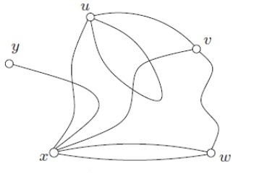
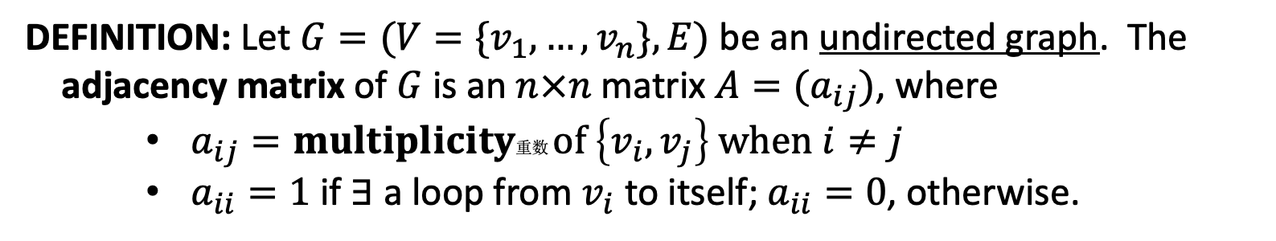
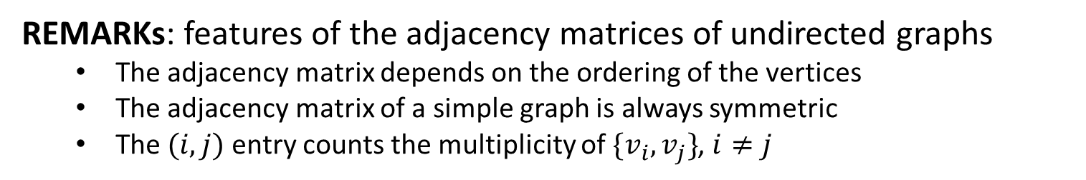
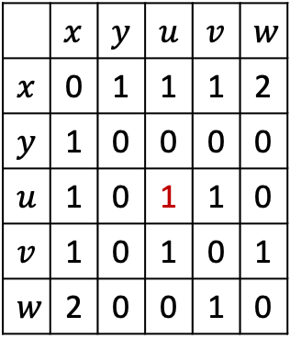
Review: Adjacency Matrix
DEFINITION: Let $G=(V=\{v_{1},…,v_{n}\},E)$ be an undirected graph. The
adjacency matrix of $G$ is an $n×n$ matrix $A=(a_{ij})$, where
$a_{ij}=multiplicity$重数 $of \left\{v_{i},v_{j}\right\} when i≠j$
$a_{ii}=1$ if $∃$ a loop from $v_{i}$ to itself; $a_{ii}=0$, otherwise.
 | $$x$$ | $$y$$ | $$u$$ | $$v$$ | $$w$$
$$x$$ | 0 | 1 | 1 | 1 | 2
$$y$$ | 1 | 0 | 0 | 0 | 0
$$u$$ | 1 | 0 | 1 | 1 | 0
$$v$$ | 1 | 0 | 1 | 0 | 1
$$w$$ | 2 | 0 | 0 | 1 | 0
REMARKs: features of the adjacency matrices of undirected graphs
The adjacency matrix depends on the ordering of the vertices
The adjacency matrix of a simple graph is always symmetric
The $(i,j)$ entry counts the multiplicity of $\{v_{i},v_{j}\}$, $i≠j$

Slide 6
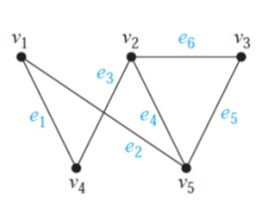
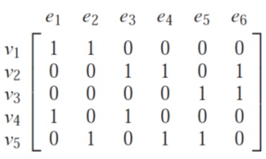
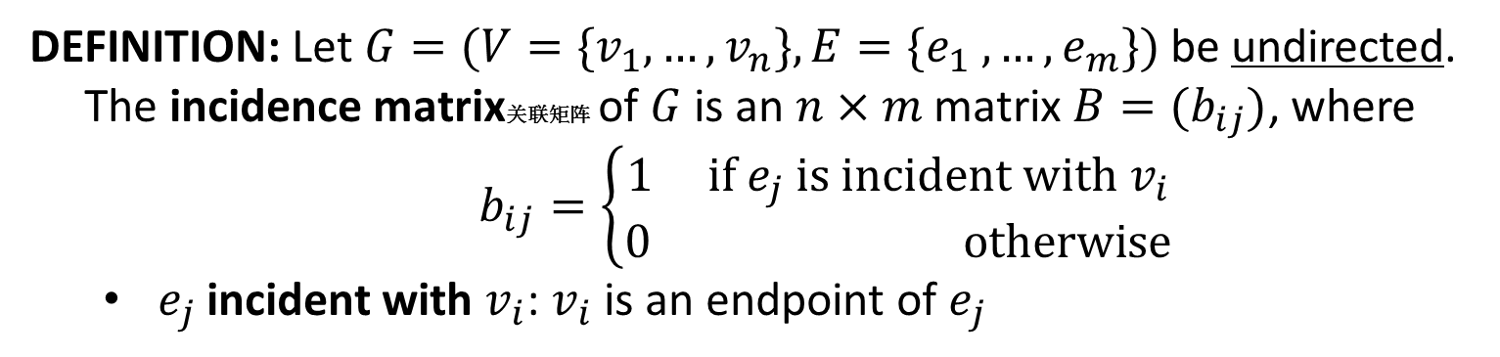
Review: Incidence Matrix
DEFINITION: Let $G=(V=\{v_{1},…,v_{n}\},E=\{e_{1} ,…,e_{m}\})$ be undirected.
The incidence matrix关联矩阵 of $G$ is an $n×m$ matrix $B=(b_{ij})$, where
$b_{ij}=\left\{\begin{aligned}1 if e_{j} is incident with v_{i} \\ 0 otherwise\end{aligned}\right.$
$e_{j}$ incident with $v_{i}$: $v_{i}$ is an endpoint of $e_{j}$

Slide 7
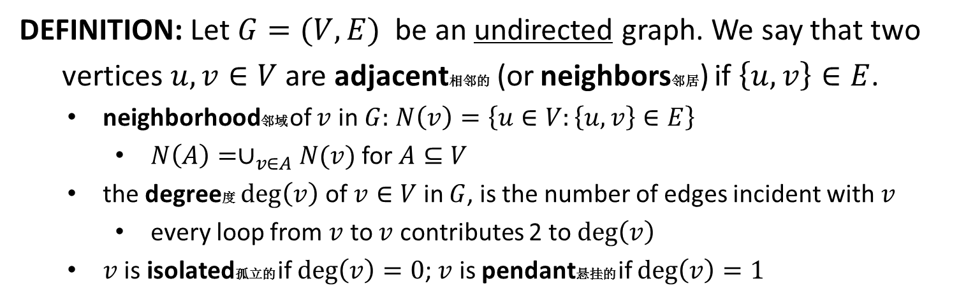
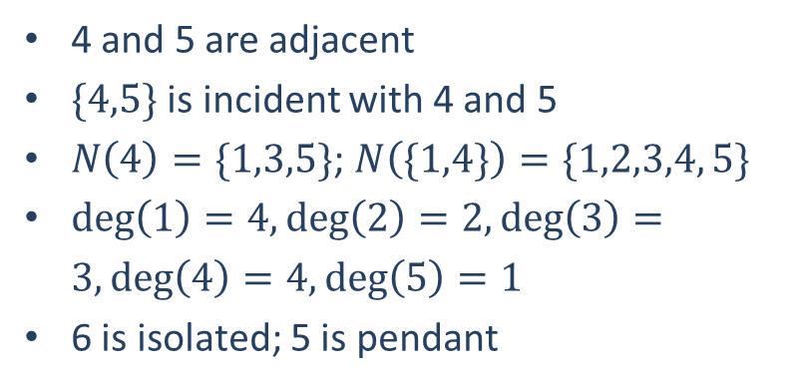
Review: Degree
DEFINITION: Let $G=(V,E)$ be an undirected graph. We say that two
vertices $u,v∈V$ are adjacent相邻的 (or neighbors邻居) if $\left\{u,v\right\}∈E$.
neighborhood邻域 of $v$ in $G:$ $N\left(v\right)=\left\{u∈V:\left\{u,v\right\}∈E\right\}$
$N\left(A\right)=∪_{v∈A}N(v)$ for $A⊆V$
the degree度 $\deg\left(v\right)$ of $v∈V$ in $G$, is the number of edges incident with $v$
every loop from $v$ to $v$ contributes 2 to $\deg\left(v\right)$
$v$ is isolated孤立的 if $\deg\left(v\right)=0$; $v$ is pendant悬挂的 if $\deg\left(v\right)=1$
4 and 5 are adjacent
$\{4,5\}$ is incident with 4 and 5
$N\left(4\right)=\{1,3,5\}$; $N\left(\{1,4\}\right)=\{1,2,3,4, 5\}$
$\deg\left(1\right)=4,\deg\left(2\right)=2,\deg\left(3\right)=3,\deg\left(4\right)=4,\deg\left(5\right)=1$
6 is isolated; 5 is pendant
1
2
4
5
6
3

Slide 8
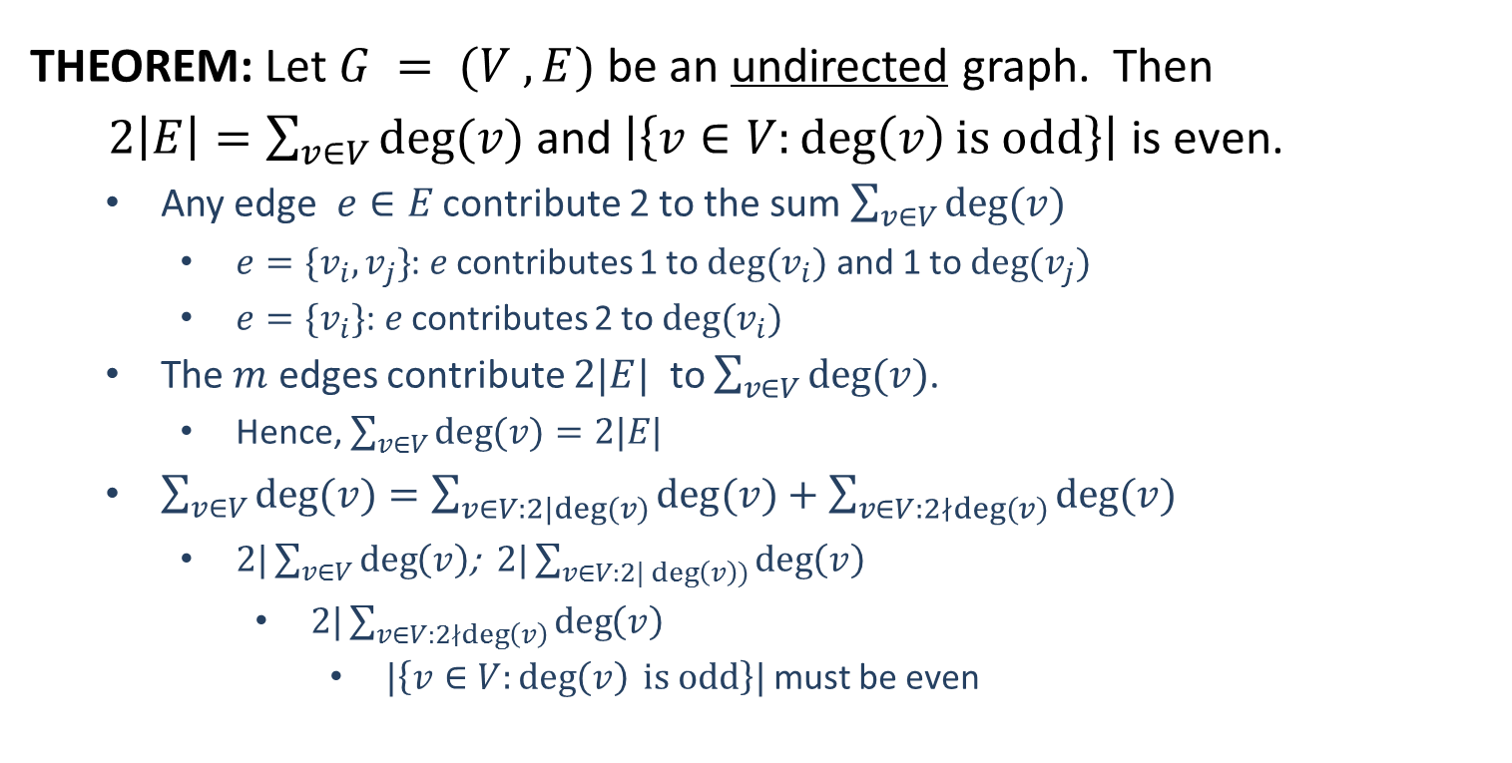
Review: Handshaking Theorem
THEOREM: Let $G = (V ,E)$be an undirected graph. Then
$2\left|E\right|=\sum_{v∈V}{deg⁡(v)}$ and $\left|\left\{v∈V:\deg\left(v\right)is odd\right\}\right|$ is even.
Any edge $e∈E$ contribute 2 to the sum $\sum_{v∈V}{\deg{(v)}}$
$e=\{v_{i},v_{j}\}$: $e$ contributes 1 to $deg⁡(v_{i})$ and 1 to $deg⁡(v_{j})$
$e=\{v_{i}\}$: $e$ contributes 2 to $deg⁡(v_{i})$
The $m$ edges contribute $2|E|$ to $\sum_{v∈V}{\deg{(v)}}$.
Hence, $\sum_{v∈V}{\deg{(v)}}=2|E|$
$\sum_{v∈V}{\deg{(v)}}=\sum_{v∈V:2|deg⁡(v)}{\deg{(v)}+\sum_{v∈V:2∤deg⁡(v)}{\deg{(v)}}}$
$2|\sum_{v∈V}{\deg\left(v\right)}$; $2|\sum_{v∈V:2|\deg\left(v\right))}{\deg\left(v\right)}$
$2|\sum_{v∈V:2∤\deg\left(v\right)}{\deg\left(v\right)}$
$|\left\{v∈V:\deg\left(v\right) is odd\right\}|$ must be even

Slide 9
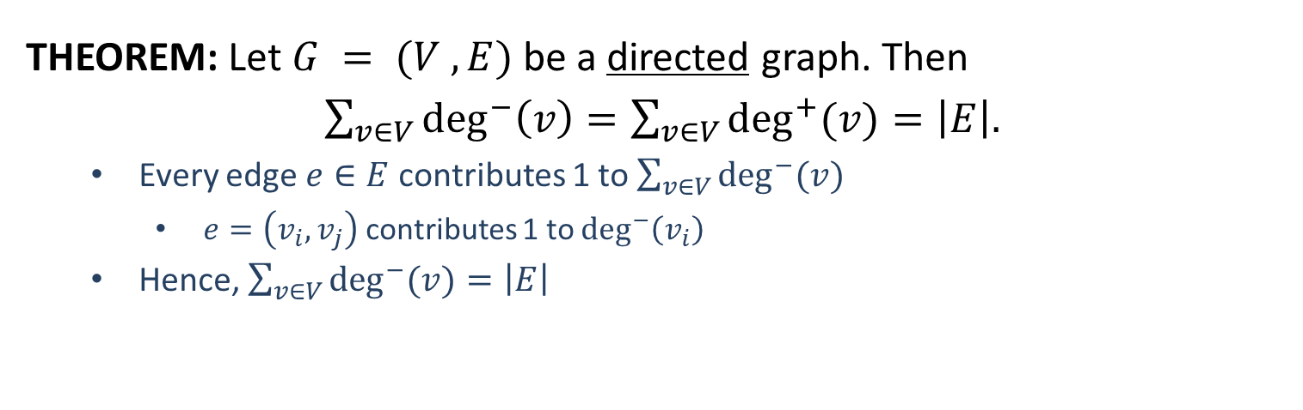

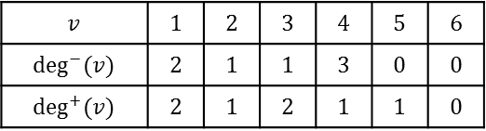
Review: Handshaking Theorem
THEOREM: Let $G = (V ,E)$be a directed graph. Then
$\sum_{v∈V}{\deg^{−}\left(v\right)=\sum_{v∈V}{\deg^{+}{(v)}}}=\left|E\right|.$
Every edge $e∈E$ contributes 1 to $\sum_{v∈V}{\deg^{−}{(v)}}$
$e=\left(v_{i},v_{j}\right)$ contributes 1 to $\deg^{−}\left(v_{i}\right)$
Hence, $\sum_{v∈V}{\deg^{−}{(v)}}=\left|E\right|$
1
1
2
4
5
6
2
4
5
6
3
3
$$v$$ | $$1$$ | $$2$$ | $$3$$ | $$4$$ | $$5$$ | $$6$$
$$deg(v)$$ | $$4$$ | $$2$$ | $$3$$ | $$4$$ | $$1$$ | $$0$$
$$v$$ | $$1$$ | $$2$$ | $$3$$ | $$4$$ | $$5$$ | $$6$$
$$\deg^{−}⁡(v)$$ | $$2$$ | $$1$$ | $$1$$ | $$3$$ | $$0$$ | $$0$$
$$\deg^{+}⁡(v)$$ | $$2$$ | $$1$$ | $$2$$ | $$1$$ | $$1$$ | $$0$$

Slide 10
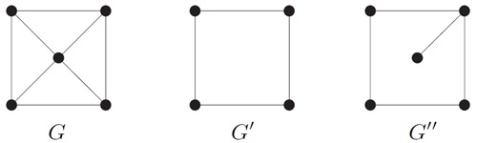

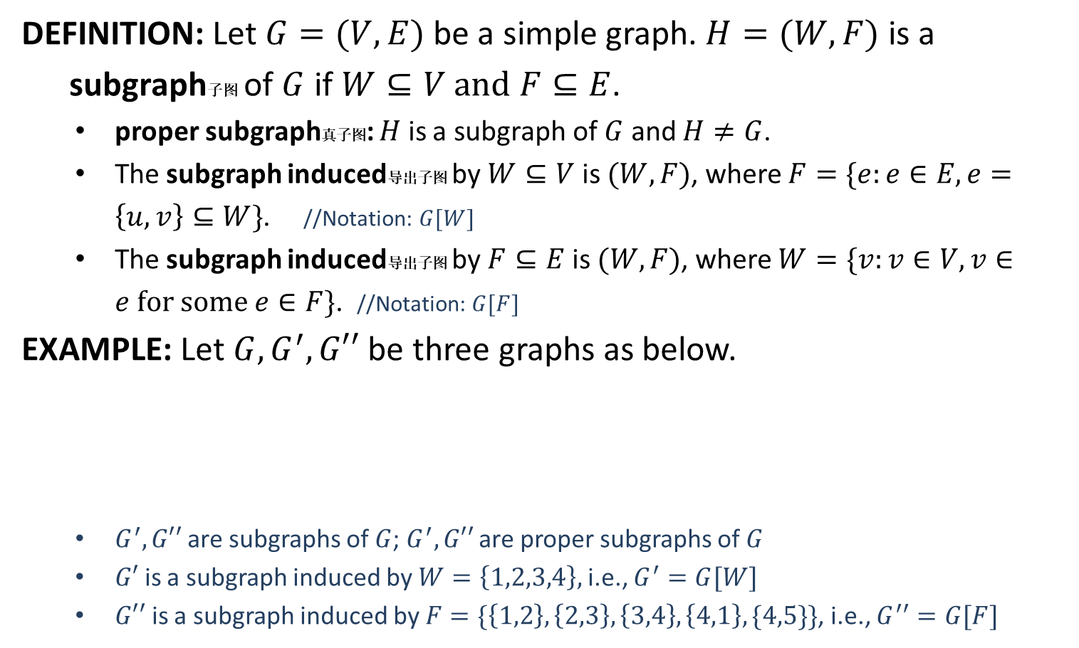




Subgraph
DEFINITION: Let $G=(V,E)$ be a simple graph. $H=(W,F)$ is a
subgraph子图 of $G$ if $W⊆V and F⊆E$.
proper subgraph真子图: $H$ is a subgraph of $G$ and $H≠G$.
The subgraph induced导出子图 by $W⊆V$ is $(W, F)$, where $F=\{e:e∈E,e=\left\{u,v\right\}⊆W\}$. //Notation: $G[W]$
The subgraph induced导出子图 by $F⊆E$ is $(W, F)$, where $W=\{v:v∈V, v∈e for some e∈F\}$. //Notation: $G[F]$
EXAMPLE: Let $G,G^{′},G′′$ be three graphs as below.
$G^{′}, G′′$ are subgraphs of $G$; $G^{′}, G′′$ are proper subgraphs of $G$
$G′$ is a subgraph induced by $W=\left\{1,2,3,4\right\},$i.e., $G^{′}=G[W]$
$G′′$ is a subgraph induced by $F=\{\left\{1,2\right\},\left\{2,3\right\},\left\{3,4\right\},\left\{4,1\right\}, \{4,5\}\}$, i.e., $G^{′′}=G[F]$
$$1$$
$$4$$
$$5$$
$$2$$
$$3$$

Slide 11
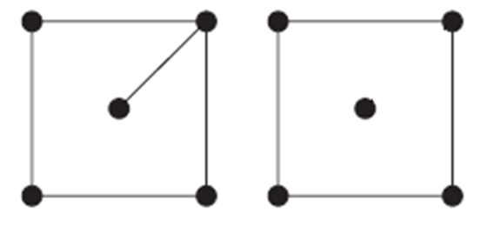




Removing An Edge
DEFINITION: Let $G=(V,E)$ be a simple graph and $e∈E.$ Define
$$G − e = (V ,E − \{e\})$$
$$e$$
$$G=(V,E)$$
$$G−e=(V,E−\{e\})$$

Slide 12
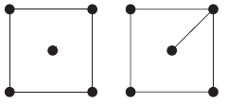




Adding An Edge
DEFINITION: Let $G=(V,E)$ be a simple graph and $e∉E.$ Define
$$G + e = (V ,E ∪ \{e\})$$
$$e$$
$$G=(V,E)$$
$$G+e=(V,E∪\{e\})$$

Slide 13
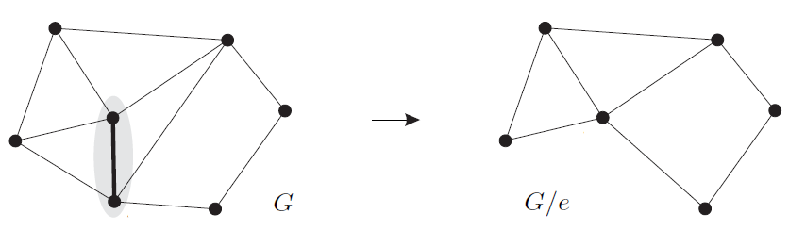



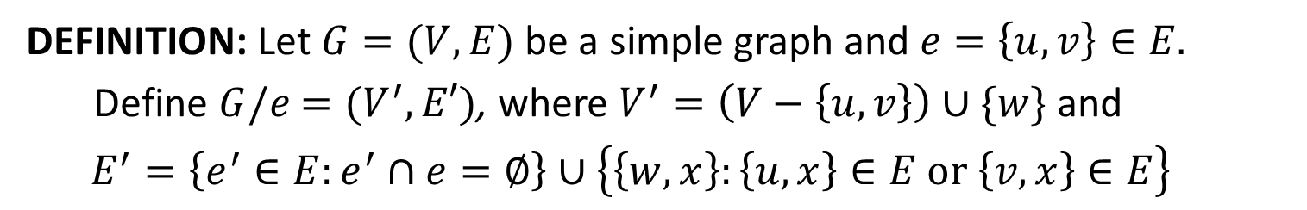











Edge Contraction
DEFINITION: Let $G=(V,E)$ be a simple graph and $e=\left\{u,v\right\}∈E.$
Define $G/e$ $=(V^{′},E′)$, where $V^{′}=\left(V−\left\{u,v\right\}\right)∪\{w\}$ and
$$E^{′}=\left\{e^{′}∈E:e^{′}∩e=∅\right\}∪\left\{\left\{w,x\right\}:\left\{u,x\right\}∈E or \left\{v,x\right\}∈E\right\}$$
$$b$$
$$c$$
$$b$$
$$c$$
$$u$$
$$y$$
$$y$$
$$a$$
$$a$$
$$w$$
$$e$$
$$v$$
$$d$$
$$d$$

Slide 14
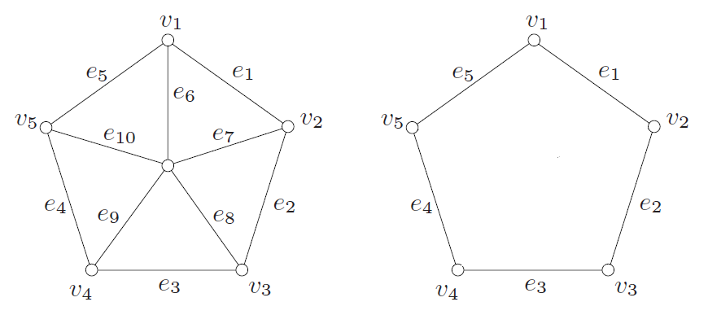




Removing A Vertex
DEFINITION: Let $G=(V,E)$ be a simple graph and let $v∈V.$ Define
$G−v=(V −\{v\}, E′)$, where $E^{′}=\{e∈E:v∉e\}$
$$v$$
$$G=(V,E)$$
$$G−v$$

Slide 15
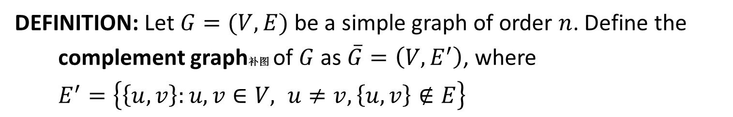


Complement
DEFINITION: Let $G=(V,E)$ be a simple graph of order $n$. Define the
complement graph补图 of $G$ as $\overline{G}=\left(V,E^{′}\right)$, where
$E^{′}=\left\{\left\{u,v\right\}:u,v∈V, u≠v, \left\{u,v\right\}∉E\right\}$
$$G$$
$$\overline{G}$$

Slide 16
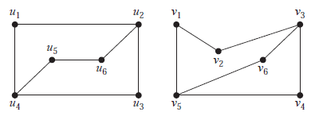
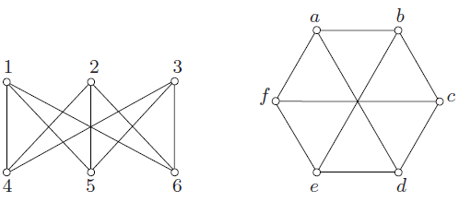

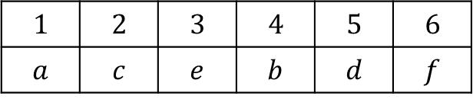
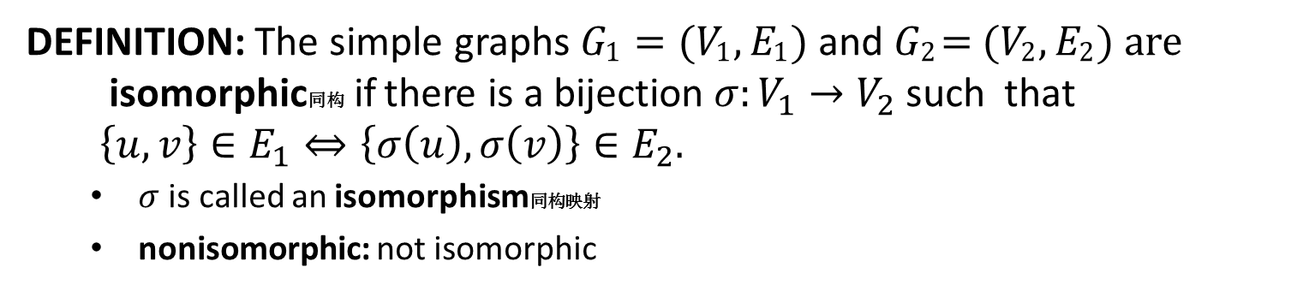

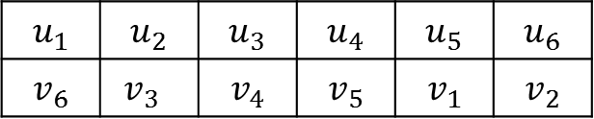
Graph Isomorphism
DEFINITION: The simple graphs 𝐺₁ = (𝑉₁, 𝐸₁) and 𝐺₂ = (𝑉₂, 𝐸₂) are
isomorphic同构 if there is a bijection $σ:V_{1}→V_{2}$ such that
$\left\{u,v\right\}∈E_{1}⇔\left\{σ\left(u\right),σ\left(v\right)\right\}∈E_{2}.$
$σ$ is called an isomorphism同构映射
nonisomorphic: not isomorphic
$$u_{1}$$ | $$u_{2}$$ | $$u_{3}$$ | $$u_{4}$$ | $$u_{5}$$ | $$u_{6}$$
$$v_{6}$$ | $v_{3}$ | $$v_{4}$$ | $$v_{5}$$ | $$v_{1}$$ | $$v_{2}$$
$$1$$ | $$2$$ | $$3$$ | $$4$$ | $$5$$ | $$6$$
$$a$$ | $$c$$ | $$e$$ | $$b$$ | $$d$$ | $$f$$
Isomorphism $σ$
Isomorphism $σ$

Slide 17
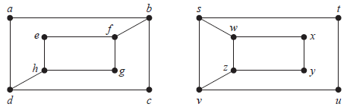
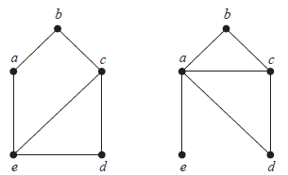
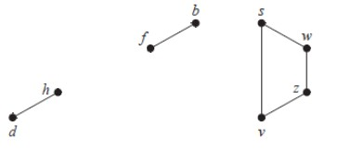
Graph Invariants
DEFINITION: Graph invariants are properties preserved by graph
isomorphism. For example,
The number of vertices
The number of edges
The number of vertices of each degree
REAMRKS: The graph invariants can be used to determine if two graphs
are isomorphic or not.
Induced subgraphs
are not isomorphic.
Original graphs are
not isomorphic.
There is no vertex of degree 4
in the 1st graph
The subgraphs induced by the vertices of degree 3
must be isomorphic to each other.

Slide 18
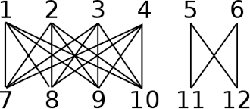
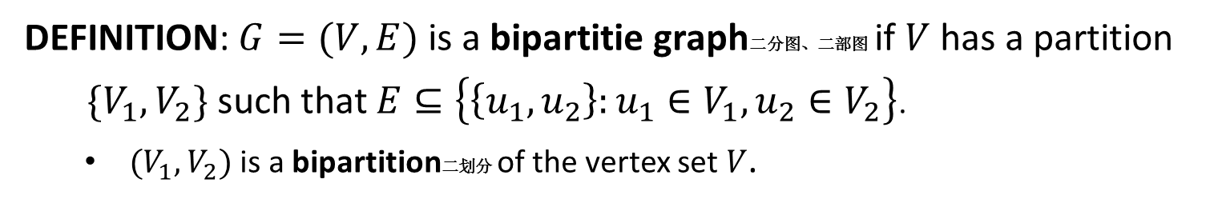
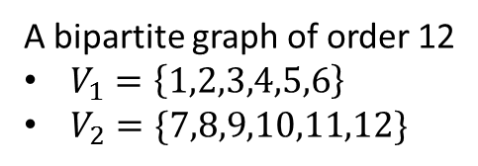
Bipartite Graph
DEFINITION: $G=(V,E)$ is a bipartitie graph二分图、二部图 if $V$ has a partition
$\{V_{1},V_{2}\}$ such that $E⊆\left\{\left\{u_{1},u_{2}\right\}:u_{1}∈V_{1}, u_{2}∈V_{2}\right\}$.
$(V_{1},V_{2})$ is a bipartition二划分 of the vertex set $V$.
A bipartite graph of order 6
A bipartite graph of order 12
$V_{1}=\left\{1,2,3,4,5,6\right\}$
$V_{2}=\{7,8,9,10,11,12\}$

Slide 19
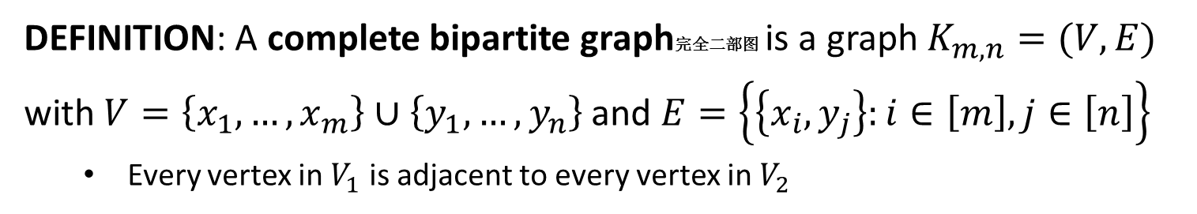
Complete Bipartite Graph
DEFINITION: A complete bipartite graph完全二部图 is a graph $K_{m,n}=(V,E)$ with $V=\left\{x_{1},…,x_{m}\right\}∪\left\{y_{1},…,y_{n}\right\}$ and $E=\left\{\left\{x_{i},y_{j}\right\}:i∈\left[m\right], j∈\left[n\right]\right\}$
Every vertex in $V_{1}$ is adjacent to every vertex in $V_{2}$

Slide 20
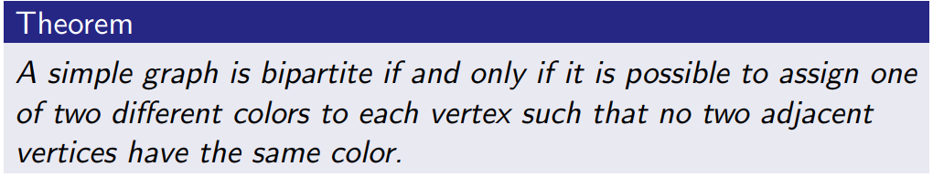
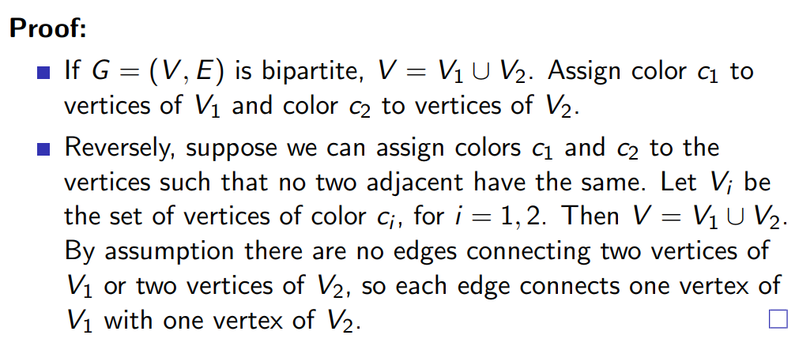
Bipartite Graph

Slide 21
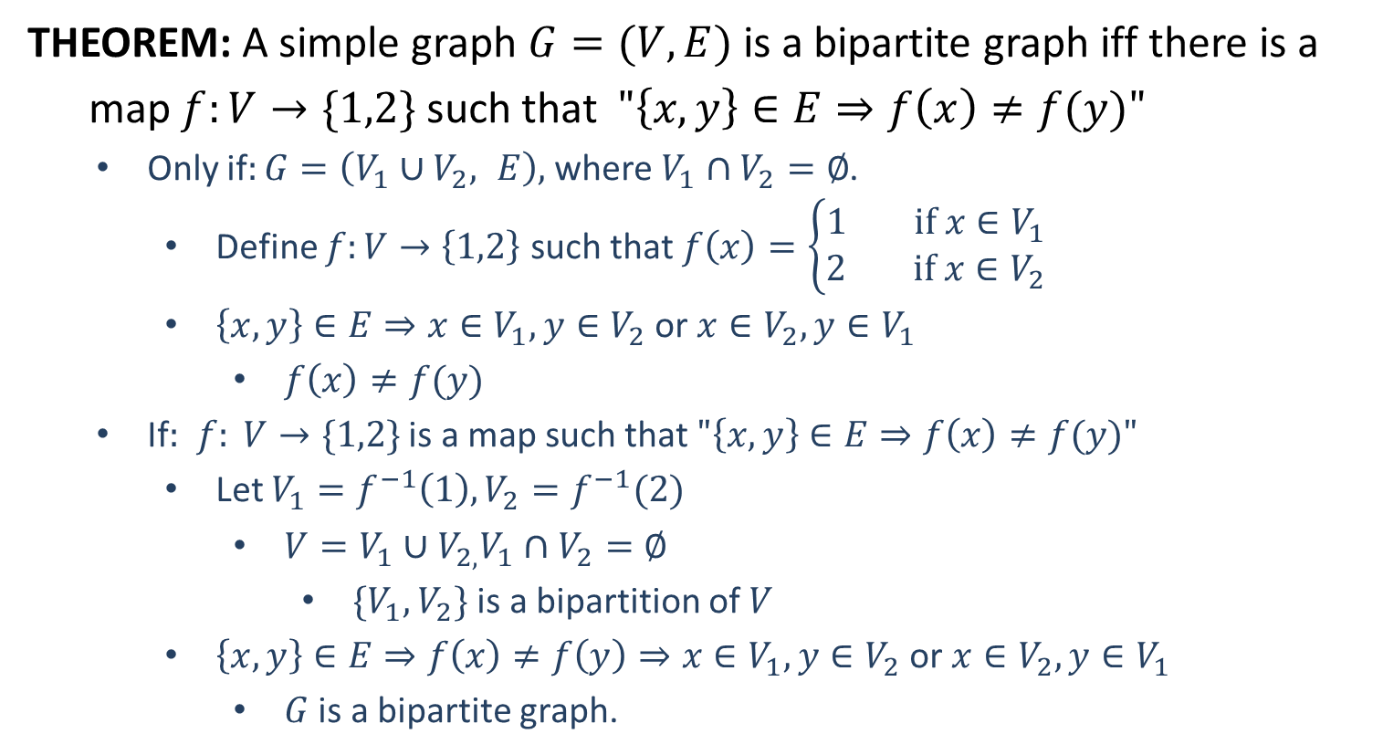
Bipartite Graph*
THEOREM: A simple graph $G=(V,E)$ is a bipartite graph iff there is a
map $f:V→\{1,2\}$ such that $"\left\{x,y\right\}∈E⇒f\left(x\right)≠f(y)"$
Only if$:G=\left(V_{1}∪V_{2}, E\right),$ where $V_{1}∩V_{2}=∅$.
Define $f:V→\left\{1,2\right\}$ such that $f\left(x\right)=\left\{\begin{aligned}1 if x∈V_{1} \\ 2 if x∈V_{2}\end{aligned}\right.$
$\left\{x,y\right\}∈E⇒x∈V_{1}, y∈V_{2}$ or $x∈V_{2}, y∈V_{1}$
$f\left(x\right)≠f(y)$
If$:$ $f: V→\{1,2\}$ is a map such that $"\left\{x,y\right\}∈E⇒f\left(x\right)≠f(y)"$
Let $V_{1}=f^{−1}\left(1\right), V_{2}=f^{−1}(2)$
$V=V_{1}∪V_{2,}V_{1}∩V_{2}=∅$
$\{V_{1},V_{2}\}$ is a bipartition of $V$
$\left\{x,y\right\}∈E⇒f\left(x\right)≠f\left(y\right)⇒x∈V_{1},y∈V_{2}$ or $x∈V_{2}, y∈V_{1}$
$G$ is a bipartite graph.
*: This indicates that this slide is an optional topic, which can be skipped.

Slide 22
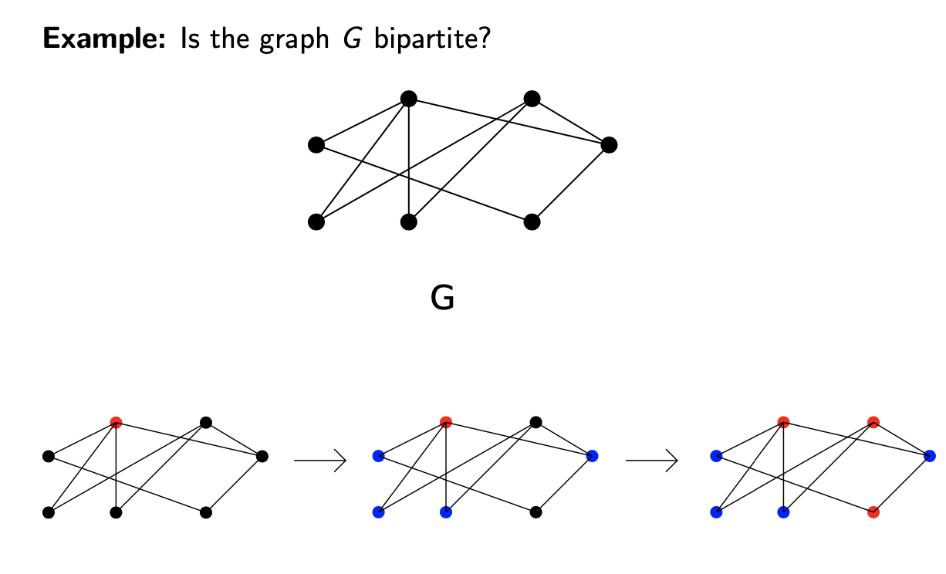
Bipartite Graph

Slide 23
Bipartite Graph

Slide 24
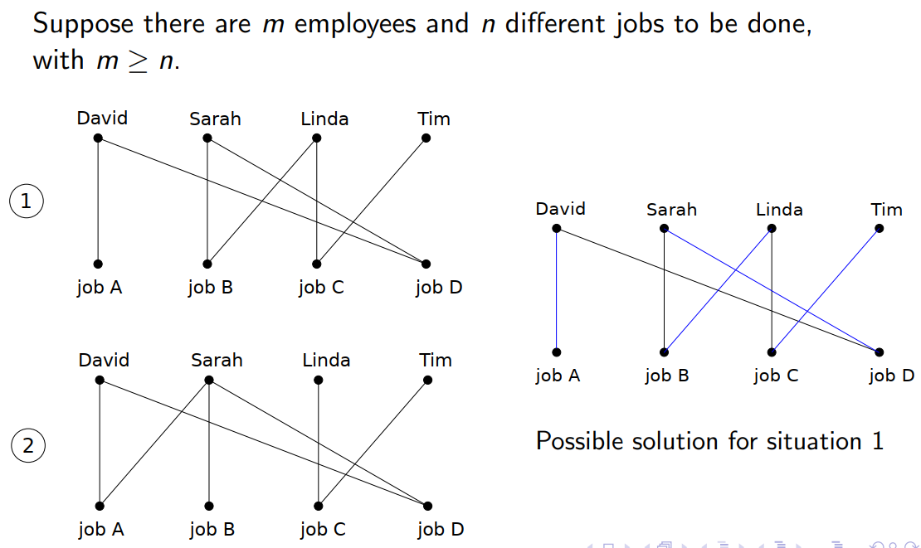
Motivation: Job Assignment

Slide 25
Motivation: Job Assignment

Slide 26

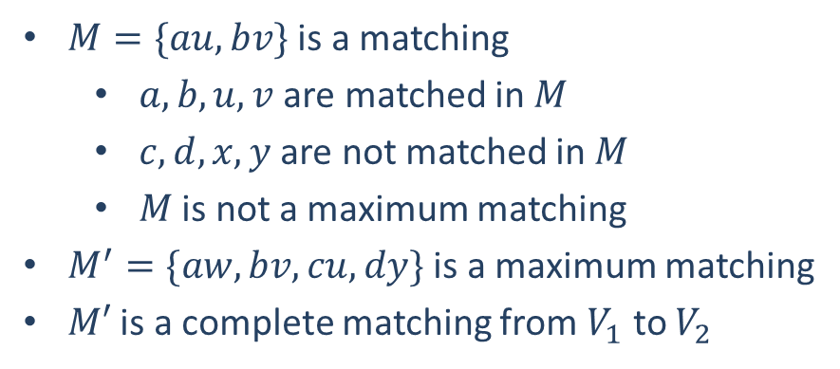
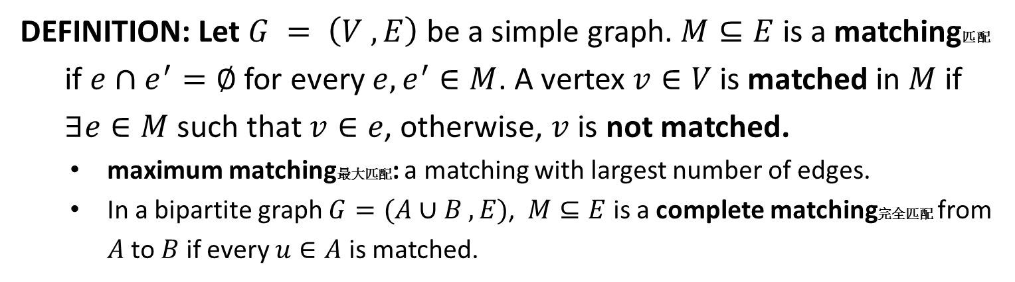








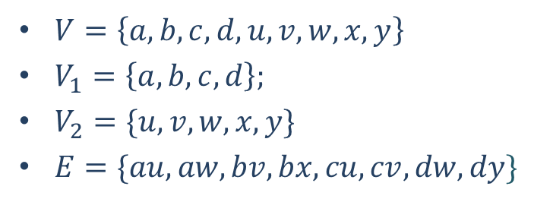
Matching
DEFINITION: Let $G = \left(V ,E\right)$ be a simple graph. $M⊆E$ is a matching匹配
if $e∩e^{′}=∅$ for every $e,e^{′}∈M$. A vertex $v∈V$ is matched in $M$ if
$∃e∈M$ such that $v∈e$, otherwise, $v$ is not matched.
maximum matching最大匹配: a matching with largest number of edges.
In a bipartite graph $G=(A∪B ,E)$, $M⊆E$ is a complete matching完全匹配 from $A$ to $B$ if every $u∈A$ is matched.
$M=\{au, bv\}$ is a matching
$a, b, u, v$ are matched in $M$
$c,d,x,y$ are not matched in $M$
$M$ is not a maximum matching
$M^{′}=\{aw,bv,cu, dy\}$ is a maximum matching
$M′$ is a complete matching from $V_{1}$ to $V_{2}$
$$a$$
$$b$$
$$c$$
$$d$$
$$u$$
$$v$$
$$w$$
$$x$$
$$y$$
$V=\left\{a,b,c,d,u,v,w,x,y\right\}$
$V_{1}=\left\{a,b,c,d\right\};$
$V_{2}=\{u,v,w,x,y\}$
$E=\{au,aw,bv,bx,cu,cv,dw,dy\}$

Slide 27
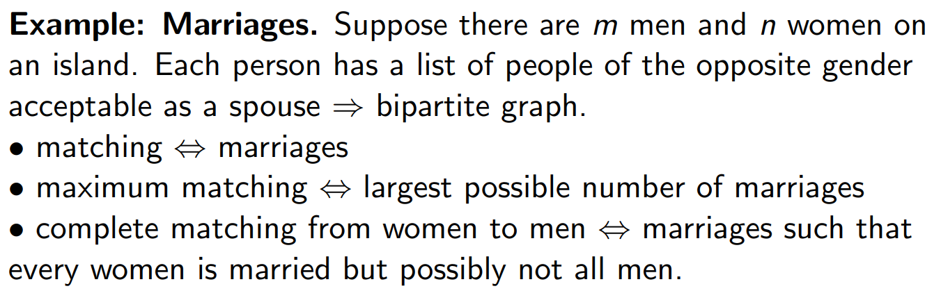
Matching
DEFINITION: Let $G = \left(V ,E\right)$ be a simple graph. $M⊆E$ is a matching匹配
if $e∩e^{′}=∅$ for every $e,e^{′}∈M$. A vertex $v∈V$ is matched in $M$ if
$∃e∈M$ such that $v∈e$, otherwise, $v$ is not matched.
maximum matching最大匹配: a matching with largest number of edges.
In a bipartite graph $G=(A∪B ,E)$, $M⊆E$ is a complete matching完全匹配 from $A$ to $B$ if every $u∈A$ is matched.

Slide 28
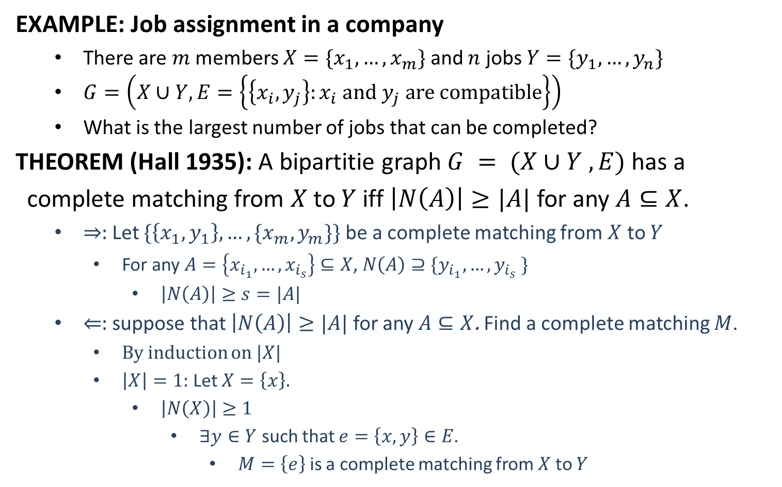
Hall’s Theorem
EXAMPLE: Job assignment in a company
There are $m$ members ${X=\{x}_{1},…,x_{m}\}$ and $n$ jobs $Y=\{y_{1},…,y_{n}\}$
$G=\left(X∪Y, E=\left\{\left\{x_{i},y_{j}\right\}:x_{i} and y_{j} are compatible\right\}\right)$
What is the largest number of jobs that can be completed?
THEOREM (Hall 1935): A bipartitie graph $G = (X∪Y ,E)$has a
complete matching from $X$to $Y$ iff $\left|N\left(A\right)\right|≥|A|$ for any $A⊆X$.
$⇒:$Let $\{\left\{x_{1},y_{1}\right\},…,\{x_{m},y_{m}\}\}$ be a complete matching from $X$ to $Y$
For any $A=\left\{x_{i_{1}},…,x_{i_{s}}\right\}⊆X$, $N\left(A\right)⊇\{y_{i_{1}},…,y_{i_{s}} \}$
$\left|N\left(A\right)\right|≥s=|A|$
$⇐:$ suppose that $\left|N\left(A\right)\right|≥|A|$ for any $A⊆X$. Find a complete matching $M$.
By induction on $|X|$
$\left|X\right|=1:$ Let $X=\left\{x\right\}.$
$\left|N\left(X\right)\right|≥1$
$∃y∈Y$ such that $e=\left\{x,y\right\}∈E$.
$M=\left\{e\right\}$ is a complete matching from $X$ to $Y$

Slide 29
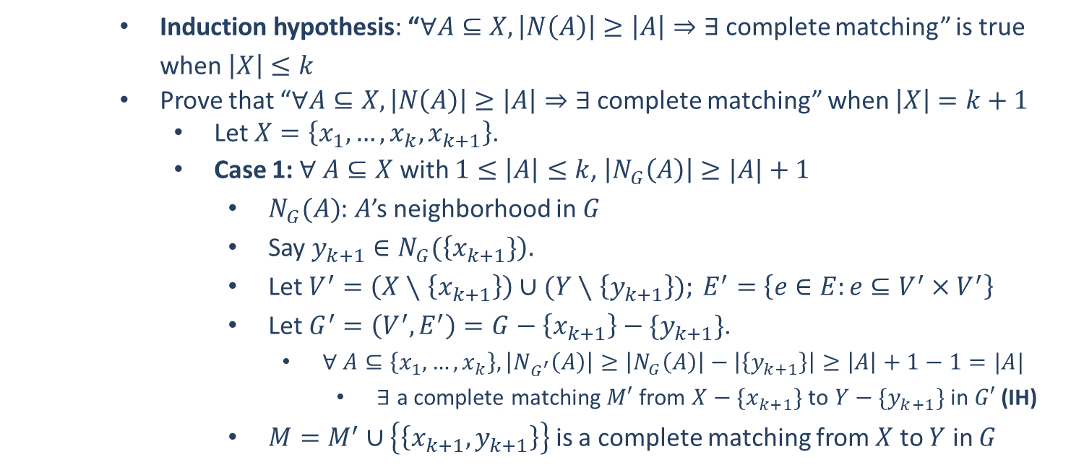
Hall’s Theorem
Induction hypothesis: “$∀A⊆X, \left|N\left(A\right)\right|≥\left|A\right|⇒∃$complete matching” is true when $\left|X\right|≤k$
Prove that “$∀A⊆X, \left|N\left(A\right)\right|≥\left|A\right|⇒∃$complete matching” when $\left|X\right|=k+1$
Let $X=\left\{x_{1},…,x_{k},x_{k+1}\right\}$.
Case 1: $∀ A⊆X$ with $1≤\left|A\right|≤k$, $\left|N_{G}\left(A\right)\right|≥|A|+1$
$N_{G}(A)$: $A$’s neighborhood in $G$
Say $y_{k+1}∈N_{G}(\left\{x_{k+1}\}\right).$
Let $V^{′}=\left(X∖\left\{x_{k+1}\right\}\right)∪(Y∖\left\{y_{k+1}\right\}); E^{′}=$ $\left\{e∈E:e⊆V^{′}×V^{′}\right\}$
Let $G^{′}=\left(V^{′},E^{′}\right)=G−\left\{x_{k+1}\right\}−\{y_{k+1}\}$.
$∀ A⊆\left\{x_{1},…,x_{k}\right\}, \left|N_{G^{′}}\left(A\right)\right|≥\left|N_{G}\left(A\right)\right|−\left|\left\{y_{k+1}\right\}\right|≥\left|A\right|+1−1=|A|$
$∃$ a complete matching $M′$ from $X−\{x_{k+1}\}$ to $Y−\{y_{k+1}\}$ in $G′$ (IH)
$M=M^{′}∪\left\{\left\{x_{k+1}, y_{k+1}\right\}\right\}$ is a complete matching from $X$ to $Y$ in $G$

Slide 30
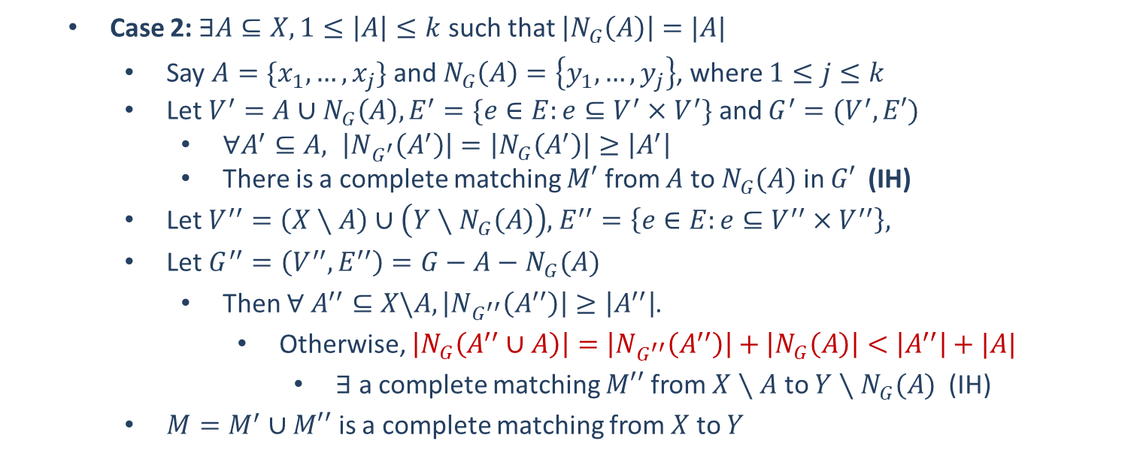
Hall’s Theorem
Case 2: $∃A⊆X, 1≤\left|A\right|≤k$ such that $\left|N_{G}\left(A\right)\right|=|A|$
Say $A=\{x_{1},…,x_{j}\}$ and $N_{G}\left(A\right)=\left\{y_{1},…,y_{j}\right\}$, where $1≤j≤k$
Let $V^{′}=A∪N_{G}\left(A\right), E^{′}=\{e∈E:e⊆V^{′}×V^{′}\}$ and $G^{′}=(V^{′},E′)$
$∀A^{′}⊆A, \left|N_{G^{′}}\left(A^{′}\right)\right|=\left|N_{G}\left(A^{′}\right)\right|≥\left|A^{′}\right|$
There is a complete matching $M′$ from $A$ to $N_{G}(A)$ in $G′$ (IH)
Let $V^{′′}=\left(X∖A\right)∪\left(Y∖N_{G}\left(A\right)\right)$, $E^{′′}=\left\{e∈E:e⊆V^{′′}{×V}^{′′}\right\},$
Let $G^{′′}=\left(V^{′′},E^{′′}\right)=G−A−N_{G}(A)$
Then $∀ A^{′′}⊆X\backslash A, \left|N_{G^{′′}}\left(A^{′′}\right)\right|≥\left|A^{′′}\right|$.
Otherwise, $\left|N_{G}\left(A^{′′}∪A\right)\right|=\left|N_{G^{′′}}\left(A^{′′}\right)\right|+\left|N_{G}\left(A\right)\right|<\left|A^{′′}\right|+|A|$
$∃$ a complete matching $M′′$ from $X∖A$ to $Y∖N_{G}(A)$ (IH)
$M=M^{′}∪M′′$ is a complete matching from $X$ to $Y$

